Slide 1

Johnathan Rodriguez
PHYS204 Final Course Project

Slide 2
PHYS204 Project Part 1
PHYS204 Project Part 1
Inventory of Parts and Software

Slide 3
Introduction
Introduction:
The best way to learn physics is by actively engaging in practical applications. This PHYS204 final project embraces this philosophy by focusing on real-world applications and experimentation.
Project Focus: The project is centered on creating a comprehensive inventory of parts and software elements that are integral to the learning and application of physics principles.
Coverage Areas:
Hardware Components: A detailed catalog of essential components used in physics experiments and demonstrations.
Software Tools: Overview of simulation and analysis software that facilitate virtual experiments and data interpretation.
Integration Techniques: Methods for effectively combining parts and software to design experiments, enhancing the practical understanding of theoretical concepts.
This project not only strengthens the conceptual grasp of physics but also equips learners with hands-on experience in managing and utilizing technical resources effectively.

Slide 4
Ultrasonic Sensor HC-SR04
Inventory of Parts and Software: Ultrasonic Sensor HC-SR04
Parts
Ultrasonic Sensor HC-SR04: This is the primary component responsible for measuring distance using ultrasonic waves.
Microcontroller (e.g., Arduino, Raspberry Pi): This device will be used to process the sensor's output and perform necessary calculations.
Breadboard: A platform for connecting the components together.
Jumper Wires: Wires used to connect the sensor and microcontroller to the breadboard.
Power Supply (e.g., USB): To provide power to the microcontroller and sensor.
Software
Programming Language (e.g., C++, Python): This will be used to write the code that interacts with the sensor and performs the necessary calculations.
Integrated Development Environment (IDE): A software application that provides a comprehensive set of tools for writing, compiling, debugging, and running computer programs.
Working Principles of Ultrasonic Sensors
Ultrasonic sensors operate on the principle of time-of-flight. They emit high-frequency sound waves (ultrasonic waves) that travel through the air. When these waves encounter an object, they are reflecting back to the sensor. By measuring the time it takes for the sound wave to travel to the object and back, the sensor can calculate the distance to the object.
References
* Adafruit: https://learn.adafruit.com/ultrasonic-sonar-distance-sensors?view=all
* SparkFun: https://learn.sparkfun.com/tutorials/qwiic-ultrasonic-distance-sensor-hc-sr04-hookup-guide/all
* Wikipedia: http://www.solidswiki.com/index.php/Ultrasonic_Sensors
* Arduino Official Documentation: https://projecthub.arduino.cc/Isaac100/getting-started-with-the-hc-sr04-ultrasonic-sensor-7cabe1

Slide 5
Rotary Encoder KY-040
• Describe the working principles of rotary encoders in detail.
• Answer:
Working Principles of Rotary Encoders
Rotary encoders are electromechanical devices that measure angular position and speed. They convert rotational mechanical displacements into electrical signals, which can then be processed to determine the position and speed of a rotating shaft.
Types of Rotary Encoders
There are two main types of rotary encoders: incremental and absolute.
* Incremental Encoders: These encoders generate a pulse train as the shaft rotates. The number of pulses can be counted to determine the angular displacement. Incremental encoders are typically used in applications where only relative position is important, such as motor control and robotics.
* Absolute Encoders: These encoders generate a unique digital code for each position of the shaft. This code can be read directly to determine the absolute position of the shaft. Absolute encoders are used in applications where precise position information is required, such as machine tools and navigation systems.
Working Principle of Rotary Encoders
The working principle of a rotary encoder is based on the detection of light or magnetic fields.
* Optical Encoders: These encoders use a rotating disc with a pattern of light and dark areas. A light source shines through the disc, and a photodetector detects the changes in light intensity as the disc rotates. The pattern of light and dark areas corresponds to a specific digital code, which can be used to determine the position of the shaft.
* Magnetic Encoders: These encoders use a rotating disc with a pattern of magnetic poles. A magnetic sensor detects the changes in magnetic field as the disc rotates. The pattern of magnetic poles corresponds to a specific digital code, which can be used to determine the position of the shaft.
References
Keyes KY-040 Rotary Encoder User Manual: https://forum.fritzing.org/t/ky-040-rotary-encoder-breakout-board-part/11073
* Wokwi KY-040 Rotary Encoder Reference: https://docs.wokwi.com/parts/wokwi-ky-040
* Billwilliams1952/KY-040-Encoder-Library---Arduino: https://github.com/dmachard/KY040-rotary

Slide 6
Hall Effect Sensor in ESP32
Describe the working principles of the Hall Effect Sensor in detail.
Answer: Working Principles of Hall Effect Sensors
Hall effect sensors are solid-state devices that measure magnetic fields. They are based on the Hall effect, which is the phenomenon of producing a voltage across an electrical conductor when a magnetic field is applied perpendicular to the current flowing through the conductor.
Components of a Hall Effect Sensor
A typical Hall effect sensor consists of the following components:
* Semiconductor material: This is usually a thin film of semiconductor material, such as gallium arsenide or indium antimonide.
* Current source: This provides a constant current to the semiconductor material.
* Magnetic field sensor: This detects the presence of a magnetic field.
* Voltage amplifier: This amplifies the small Hall voltage generated by the sensor.
* Output: This provides a voltage or current signal that is proportional to the strength of the magnetic field.
Working Principle of Hall Effect Sensors
When a current flows through the semiconductor material, the charge carriers (electrons or holes) are moving through the material. If a magnetic field is applied perpendicular to the direction of current flow, the charge carriers will experience a force that will cause them to deflect to one side of the material. This deflection of the charge carriers will create a voltage difference across the width of the material, which is known as the Hall voltage.
The magnitude of the Hall voltage is proportional to the strength of the magnetic field and the current flowing through the material. Therefore, by measuring the Hall voltage, it is possible to determine the strength of the magnetic field.
Honeywell: https://www.ti.com/sensors/magnetic-sensors/linear-hall-effect-sensors/products.html
• Magnetic Sensors: https://sps.honeywell.com/us/en/products/sensing-solutions/industrial-sensing/industrial-sensors/magnetic-sensors
• Hall effect – Wikipedia https://en.m.wikipedia.org/wiki/Hall_effect

Slide 7

Screenshots
What tool will you used to take screenshots? How does it work?
Using the Snipping Tool for Your PowerPoint Project
What is the Snipping Tool?
It's a built-in Windows tool that lets you capture a specific part of your screen as an image.
How to Use It:
* Open the Snipping Tool: Search for "snipping tool" in the Windows search bar and open it.
* Choose a Mode: Select the type of snip you want (free-form, rectangular, window, or full-screen).
* Capture the Screen: Click and drag your cursor to select the area you want to capture.
* Save the Image: Once you've captured the image, you can save it to your computer.
Inserting the Screenshot into PowerPoint:
* Open PowerPoint: Go to your presentation.
* Insert the Image: Click on the "Insert" tab, then select "Pictures." Navigate to the location where you saved your screenshot and insert it into your slide.

Slide 8

Required Software
Screenshot of Microsoft Excel installed and running on your computer

Slide 9
PHYS204 Project Part 2
Precision of the Ultrasonic Sensor

Slide 10
Rubric – Due at the end of Week 3
Activity | Requirement(s) | Points
Data collection | Complete table with data | 20
Data analysis | Calculate values to validate data and include correct units | 15
Conclusions | Answer all questions to draw valid conclusions from data | 15

Slide 11
Data Collection
Trial | Ruler Distance (cm) | Total Roundtrip Distance (m) | Time from Serial Monitor (microseconds) | Roundtrip time (s) | Velocity = distance/time (m/s)
1 | 8 | 0.16 m | 492 | 0.000492 | 016/0.000492 = 325 m/s
2 | 10 | 0.01 | 586 | 0.000586 | 17.06
3 | 15 | 0.015 | 925 | 0.000925 | 16.22
4 | 20 | 0.02 | 1187 | 0.001187 | 16.85
5 | 30 | 0.03 | 1724 | 0.001724 | 17.4

Slide 12

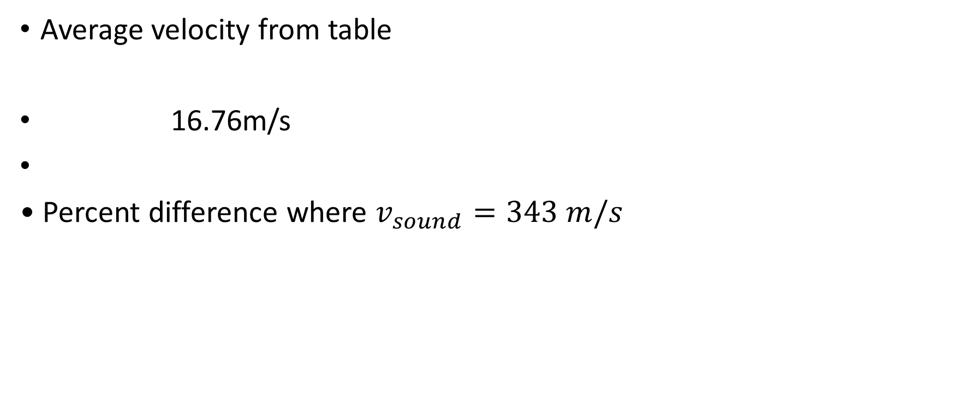
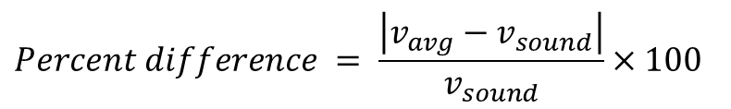
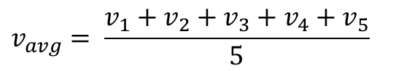
Data Analysis
Average velocity from table
16.76m/s
• Percent difference where $v_{sound}=343 m/s$
$$v_{avg}= \frac{v_{1}+v_{2}+v_{3}+v_{4}+v_{5}}{5}$$
$$Percent difference = \frac{\left|v_{avg}−v_{sound}\right|}{v_{sound}}×100$$
0.175%

Slide 13

Conclusions
Briefly describe and explain the results.
Answer: The speed of sound is directly proportional to the square root of the absolute temperature. slightly increases with humidity, and is only slightly affected my atmospheric pressure. These factors can introduce errors in measurements if not accounted for
What is the dependence of temperature, humidity, and atmospheric pressure on the speed of sound? How does it affect the results?
Answer: The Dependance of the speed of sound on temperature, humidity, and atmospheric pressure can introduce errors in measurements if these factors are not accounted for. For example, if the temperature is not constant during an experiment, the speed of sound will vary, leading to inaccuracies in the results. Similarly, changes in humidity and atmospheric pressure can also affect the speed of sound and introduce errors

Slide 14
PHYS204 Project Part 4
Conservation of Energy of a Free-Falling Object

Slide 15
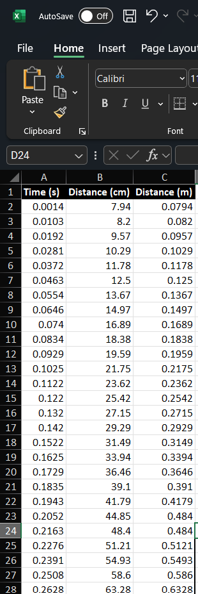
Excel Table (Screenshot)
Include all values in the Excel table for a single trial showing the fall distance in centimeters and meters as a function of time

Slide 16
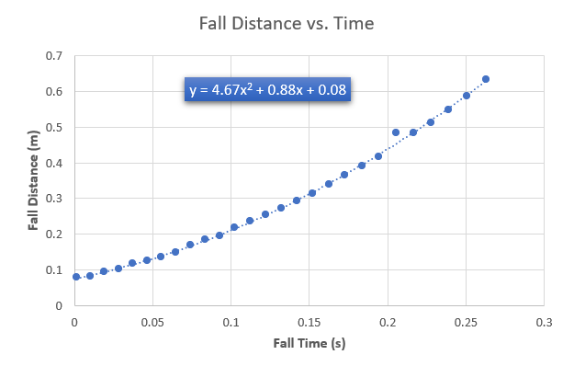
Excel Graph (Screenshot)
Excel Graph (Screenshot)

Slide 17
Data Collection
Trial | x² coefficient value from curve fitting | Acceleration (m/s²) = 2* (x² coefficient)
1 | 56.71 | 113.42
2 | 0.082 | 0.164
3 | 4.98 | 9.96
4 | 3.66 | 7.32
5 | 3.16 | 6.32

Slide 18
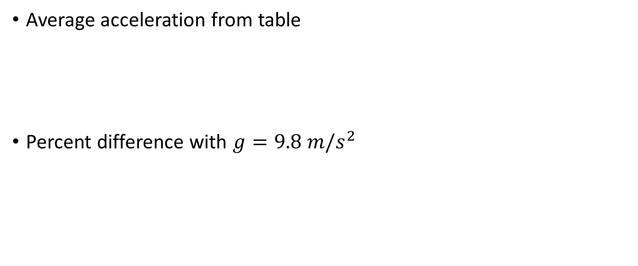
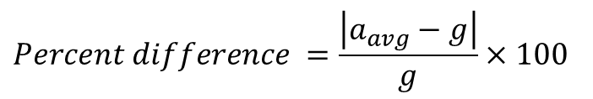
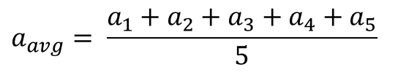
Data Analysis
Average acceleration from table
Percent difference with $g=9.8 m/s^{2}$
$$a_{avg}= \frac{a_{1}+a_{2}+a_{3}+a_{4}+a_{5}}{5}$$
19.3311 m/ss
$$Percent difference =\frac{\left|a_{avg}−g\right|}{g}×100$$
97.26% m/s

Slide 19

Conclusions
Briefly describe and explain the results.
Answer: The variation from trial to trial indicates the reliability and uncertainty of the results. A small variation suggests high reliability while a large variation indicates greater uncertainty.
How much variation is there from trial to trial? What does this indicate about the uncertainty of the result?
Answer: The variation from trial to trial is quantified using metrics like the range and standard deviation. A small range and low standard deviation indicate low variation, suggesting high reliability and lower uncertainty in the results. Conversely, a large range and high standard deviation indicate significant variation, which suggests greater uncertainty about the results.

Slide 20
PHYS204 Project Part 5
Relationship between Linear and Rotational Motion

Slide 21

Relationship Between Linear and Rotational Motion
Functionality Fundamental Connection: Linear and rotational motion are interconnected, with rotational variables serving as angular counterparts to linear variables. This relationship allows for the translation of concepts such as displacement, velocity, and acceleration from linear motion to rotational contexts.
Key Features:
Corresponding Quantities:
Equations of Motion: The equations governing linear motion have analogous forms in rotational motion, facilitating the calculation of rotational dynamics using familiar linear concepts.
Understanding these parallels enhances comprehension of motion dynamics, enabling analysis and problem-solving in mechanical systems.
Displacement: Linear displacement is measured in meters, while rotational displacement (angle) is measured in radians.
Velocity: Linear velocity is the rate of change of linear displacement (m/s), whereas angular velocity is the rate of change of angular displacement (radians/s).

Slide 22
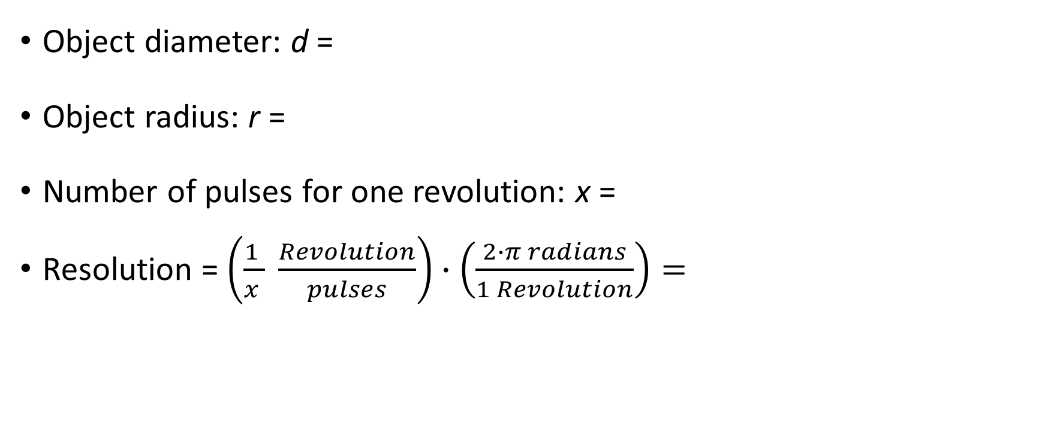
Data Collection
Object diameter: d =
Object radius: r =
Number of pulses for one revolution: x =
Resolution = $\left(\frac{1 }{x } \frac{Revolution}{pulses}\right)∙\left(\frac{2∙π radians}{1 Revolution}\right)=$
7 cm
3.5 cm
40
0.157 Rad/pulse

Slide 23
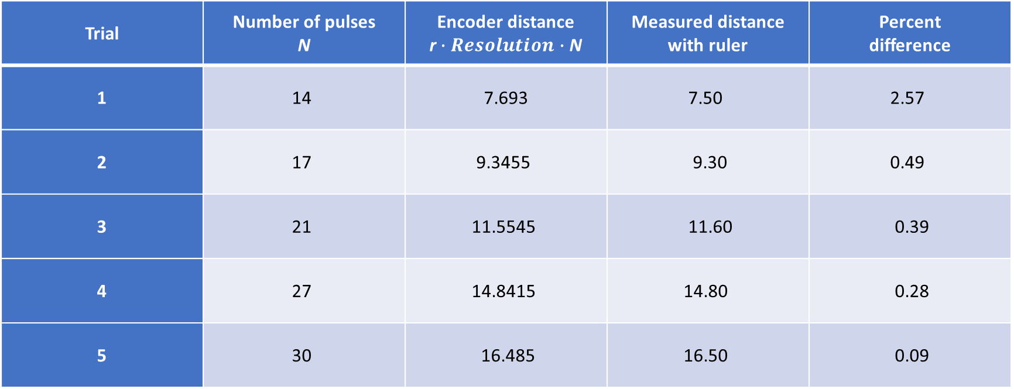
Data Analysis
Trial | Number of pulses N | Encoder distance r$∙Resolution∙$ N | Measured distance with ruler | Percent difference
1 | 14 | 7.693 | 7.50 | 2.57
2 | 17 | 9.3455 | 9.30 | 0.49
3 | 21 | 11.5545 | 11.60 | 0.39
4 | 27 | 14.8415 | 14.80 | 0.28
5 | 30 | 16.485 | 16.50 | 0.09

Slide 24
PHYS204 Project Part 6
Observing the Hall Effect

Slide 25
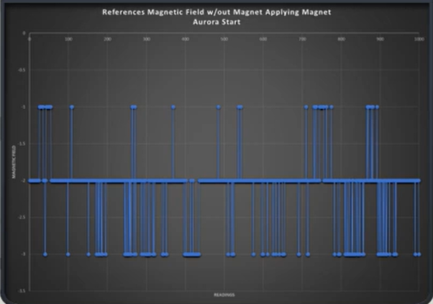
Excel Graph (Screenshot)
Johnathan Rodriguez
Include Excel graph for a single trial of data plotted as a function of time.
Must include your name in the title of the graph.

Slide 26
Challenges
Challenges Faced and Overcome:
Complex Problem Solving: Navigating intricate problems required innovative strategies and adaptive thinking. Overcoming these challenges involved iterative testing and collaboration, leading to improved problem-solving skills and project refinement.
Most Difficult Parts of the Project:
Integration of Systems: Merging various components into a cohesive system presented significant difficulties. Ensuring compatibility and seamless communication between different parts demanded extensive troubleshooting and optimization.
Data Analysis and Interpretation: Processing and interpreting large datasets required advanced analytical skills and tool proficiency. Addressing these challenges involved refining data handling techniques to ensure accuracy and meaningful insights.
This breakdown clearly articulates the project challenges and the most difficult aspects encountered during its execution.

Slide 27
Career Skills
Delete the text on this slide and replace it with the career skills that covers the items below:
Skills Developed Benefitting Your Career:
Analytical Problem Solving: Enhanced ability to systematically address complex challenges, which is crucial for decision-making and strategic planning in professional settings.
Technical Proficiency: Gained expertise in using advanced tools and technologies, increasing efficiency and effectiveness in technical roles and projects.
Competencies for Career Advancement Opportunities:
Collaboration and Teamwork: Strengthened capability to work productively within a team, fostering a cooperative environment that is essential for successful project outcomes and leadership roles.
Adaptability and Learning Agility: Developed the ability to quickly learn and adapt to new situations and technologies, positioning you to seize growth opportunities and thrive in dynamic work environments.
These skills and competencies provide a strong foundation for career development and progression in various fields.

